Slide 1



CONNECTIVITY &
COMMUNICATION PROTOCOLS
1
Version 1.0.0
Notes:
1

Slide 2

Agenda
Overview
WiFi
Bluetooth
RFID & NFC
Zigbee
Lora
2

Slide 3
Agenda (conts)
GPRS/3G/4G
HTTP/WebSocket
MQTT
CoAP
AMQP
3

Slide 4
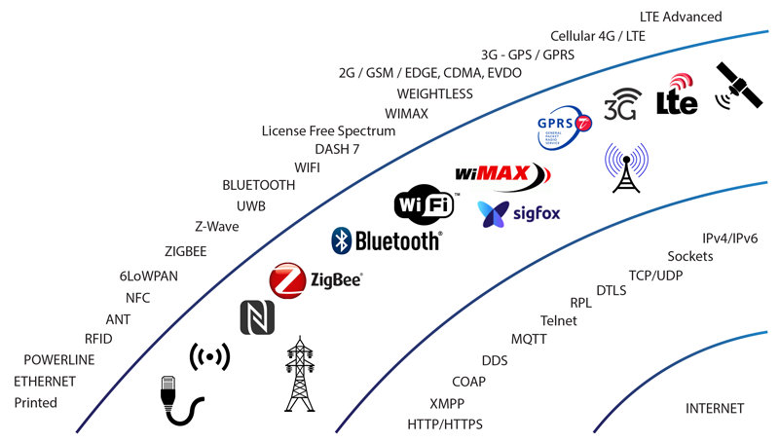
1.Overview
4

Slide 5
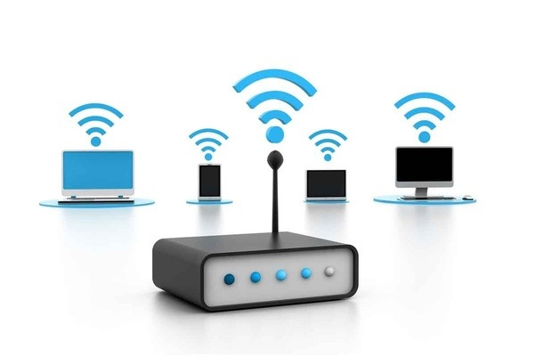
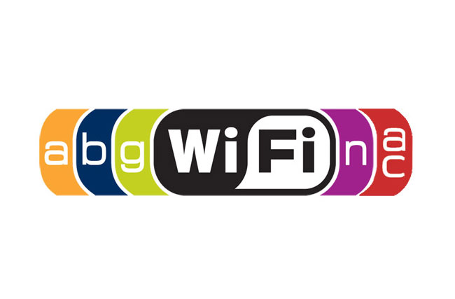
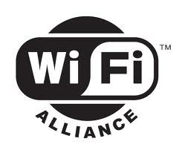
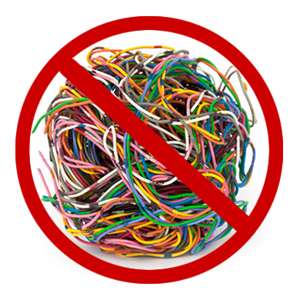
2.WiFi
Managed by Wi-Fi Alliance
Introduced in 1999
Connects without the wires
Uses radio technology
5

Slide 6
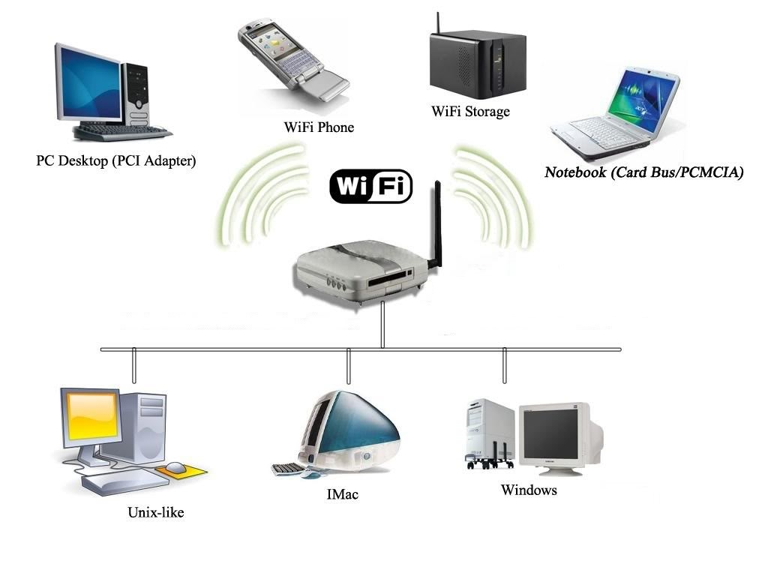
How WiFi works?
5.0
6

Slide 7


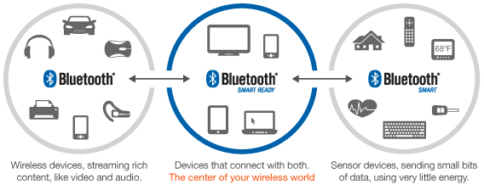
3.Bluetooth
Managed by Bluetooth Special Interest Group (SIG)
Invented in 1994
Connects without the wires
Uses radio technology
5.0
LOW ENERGY | SMART
7

Slide 8
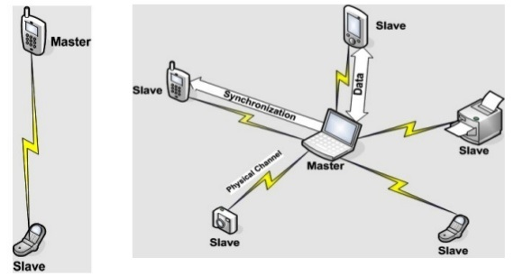
How Bluetooth works?
5.0
8

Slide 9
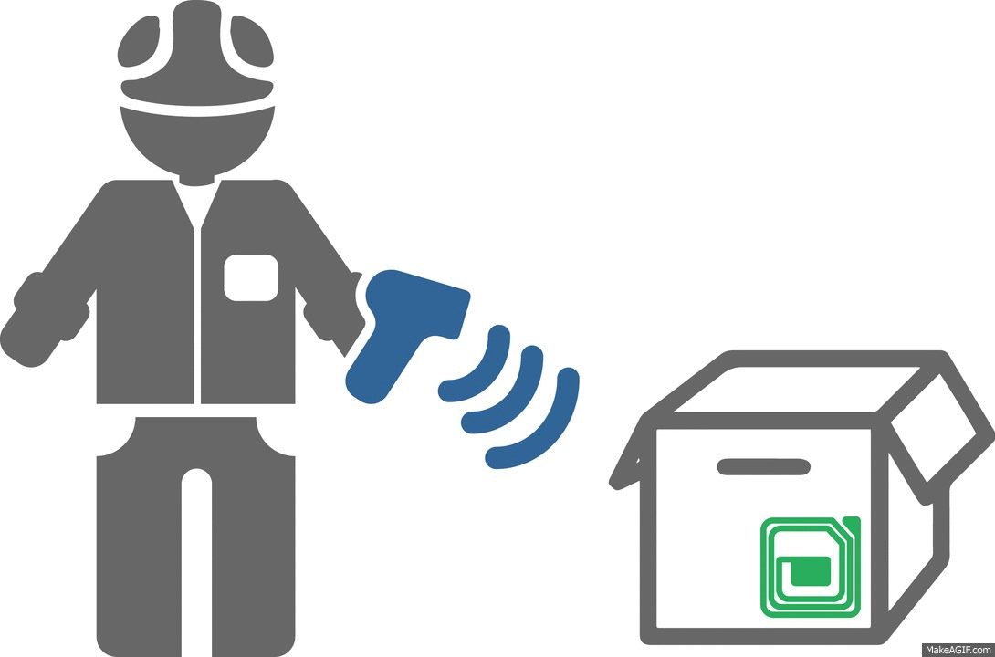

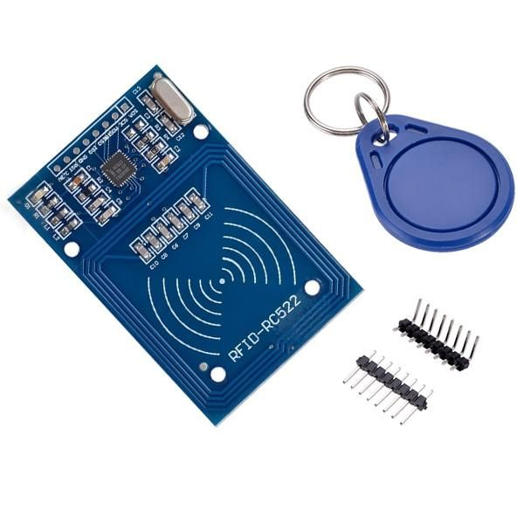
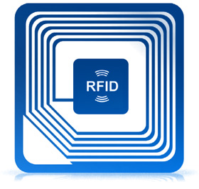
4.RFID
Radio Frequency Identification
Connects without the wires
Uses radio technology (LF, HF, UHF, MV)
Sort range
5.0
9

Slide 10
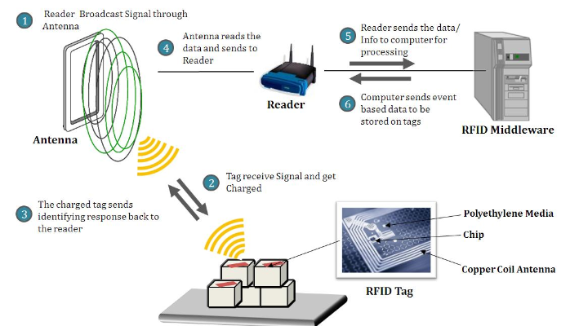
How RFID works?
5.0
10

Slide 11
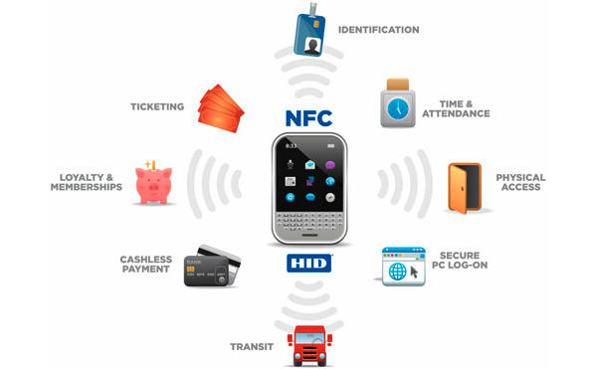
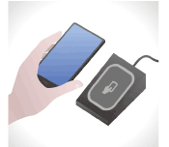

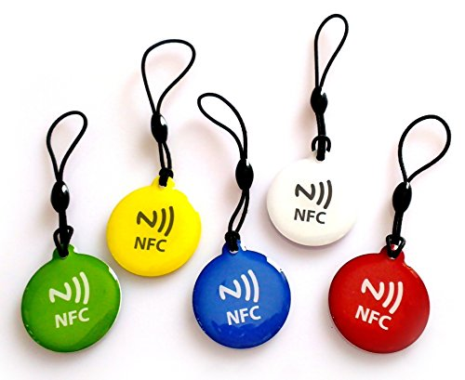
4.NFC
Near-Field Communications
A branch of RFID
Uses radio technology (HF)
Sort range (1 – 10cm)
5.0
11

Slide 12
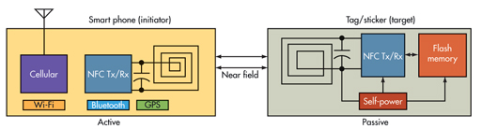
How NFC Works?
5.0
12

Slide 13
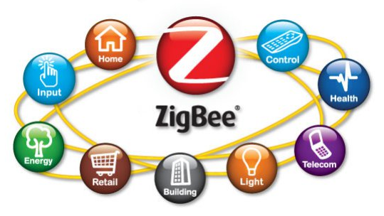
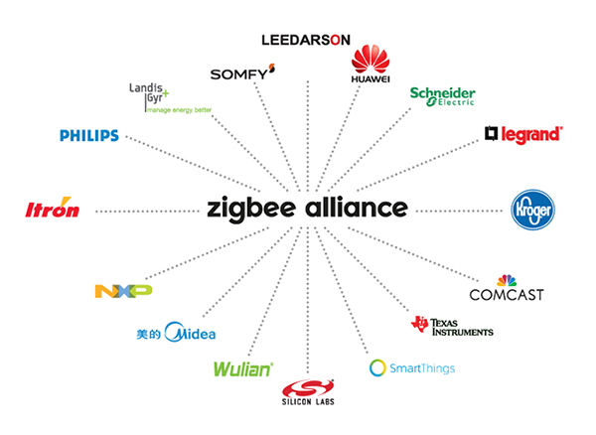
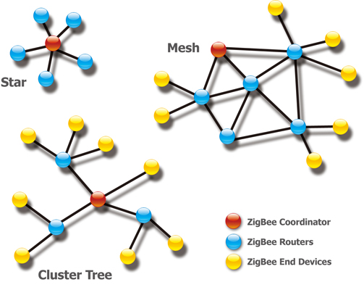
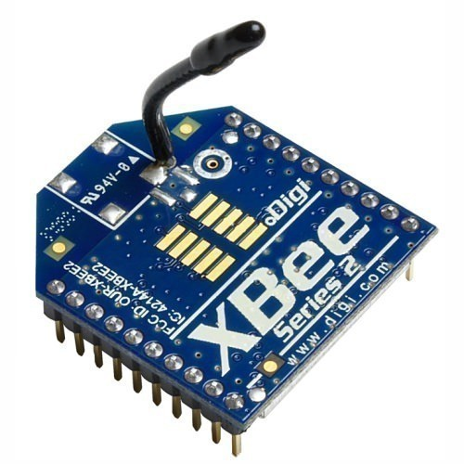
5.Zigbee
Created by Zigbee Alliance
Published in 2005
Short Range (up to 75m)
3 versions (IP, PRO, RF4CE)
5.0
13

Slide 14
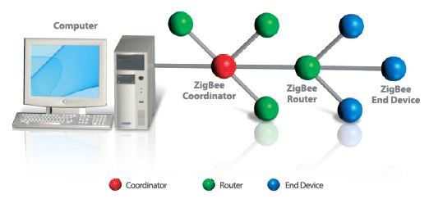
Zigbee devices
Coordinator is the brains of the network
Router act as intermediate routers or transmit data
End Device is the node in the network
5.0
14

Slide 15
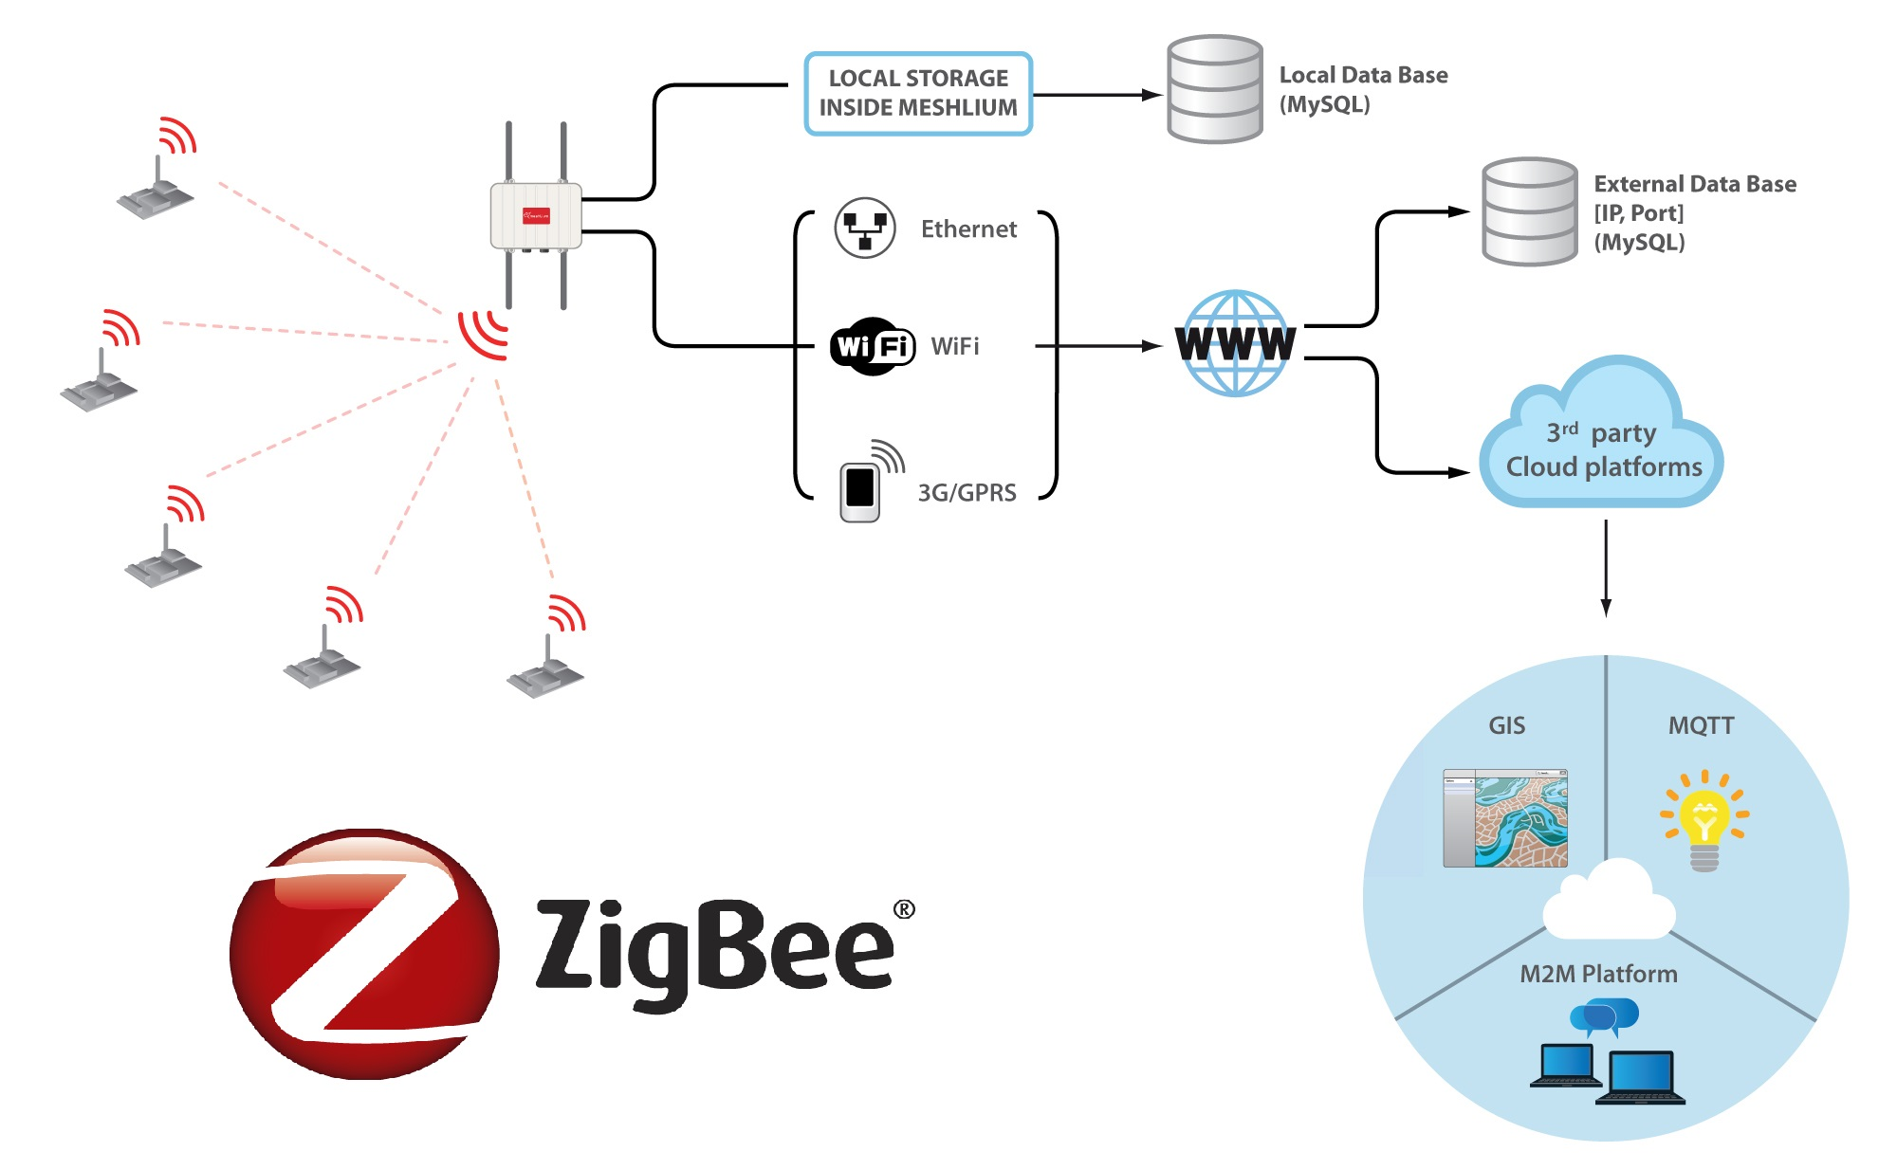
How Zigbee Works?
5.0
15

Slide 16

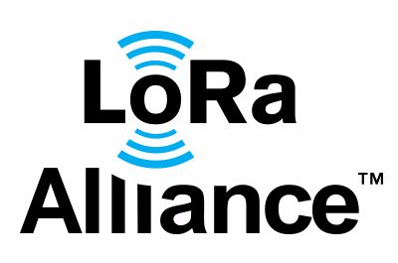
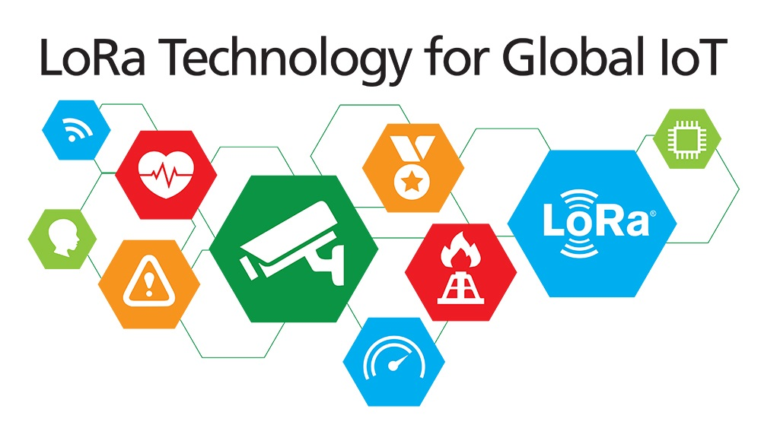
6.LoRa
Long Range (up to 5km)
Low Power Wide Area Network (LPWAN)
Specified by LoRa Alliance
Star-of-stars topology
4 versions (1.0.0, 1.0.1, 1.0.2, 1.1)
5.0
16

Slide 17
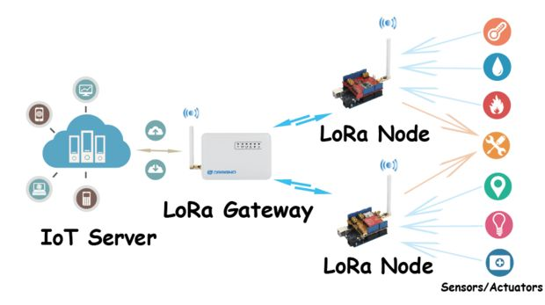
How LoRa Works?
5.0
17

Slide 18


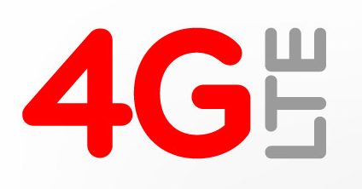
7.GPRS/EDGE/3G/4G
General Packet Radio Service
Third-generation of mobile phone technology
Fourth-generation of mobile phone technology
Sent and received data over mobile telephone network
5.0
18

Slide 19
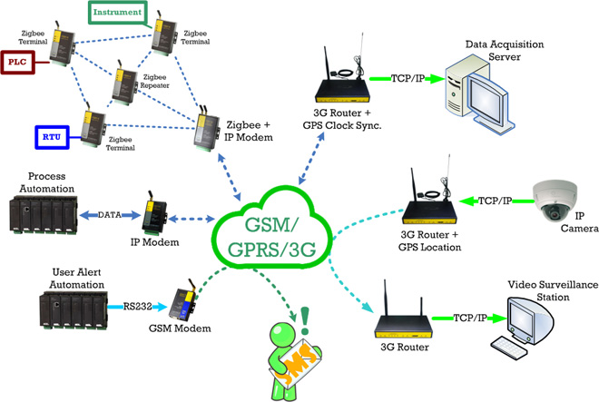
How GPRS/3G/4G Works?
5.0
19

Slide 20


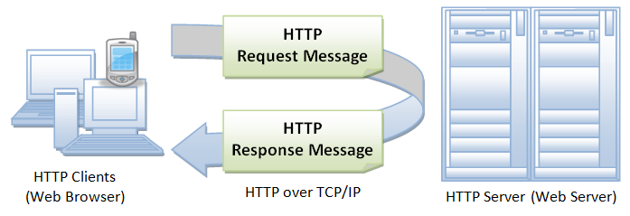
8.HTTP
Hyper Text Transfer Protocol
One-way(uni-directional) communication
Run over TCP protocol
Use protocols http:// and https://
5.0
20

Slide 21
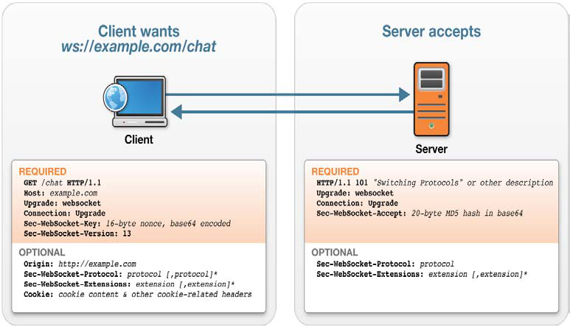

8.WebSocket
Reduce HTTP header size, Low latency, Realtime
Two-way(bi-directional) communication
Run over TCP protocol
Use protocols ws:// and wss://
21

Slide 22
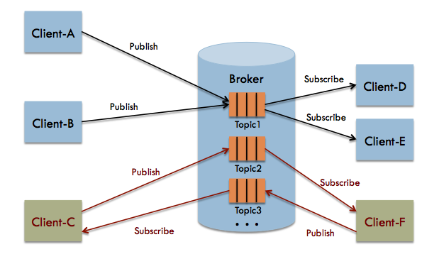


9.MQTT
Message Queuing Telemetry Transport
Machine-to-machine (M2M)
Low-bandwidth, High-latency
Support Publish and Subscribe messages
5.0
22

Slide 23
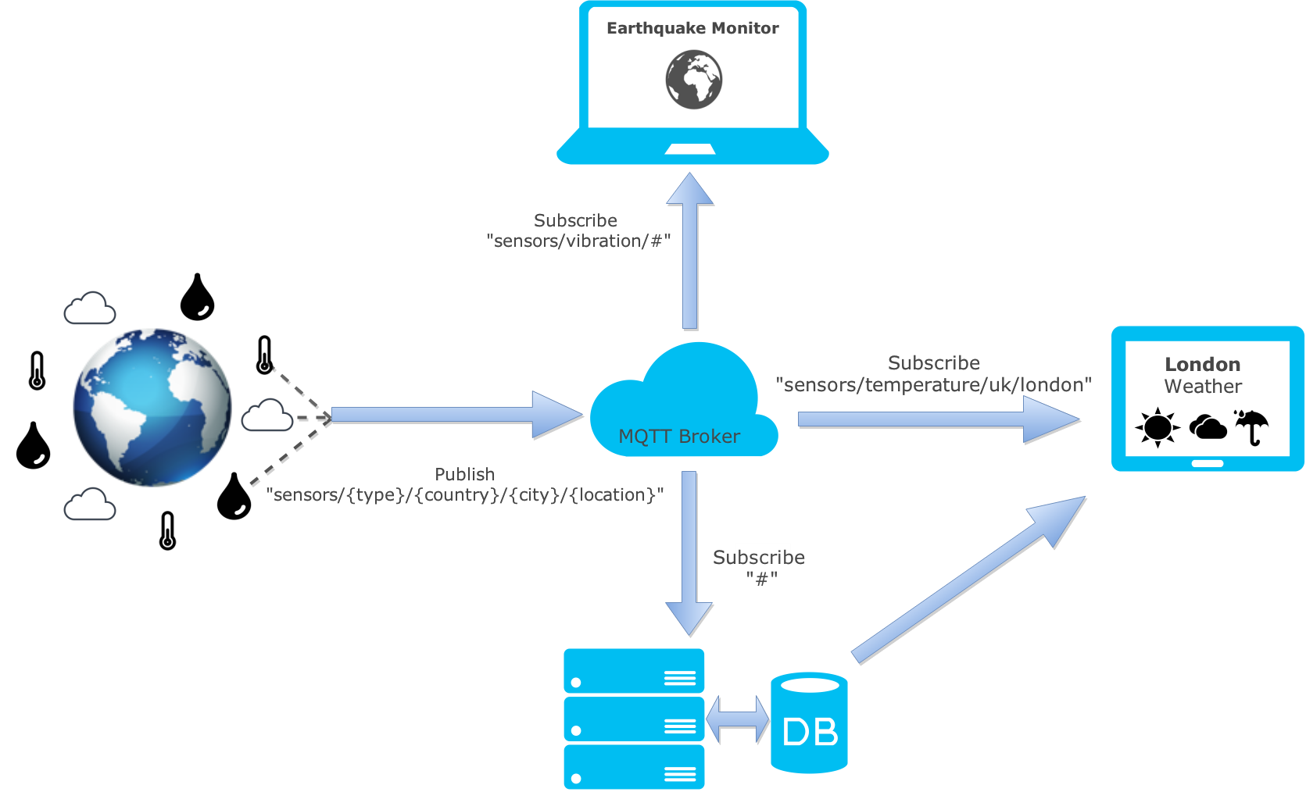
How MQTT Works?
5.0
23

Slide 24
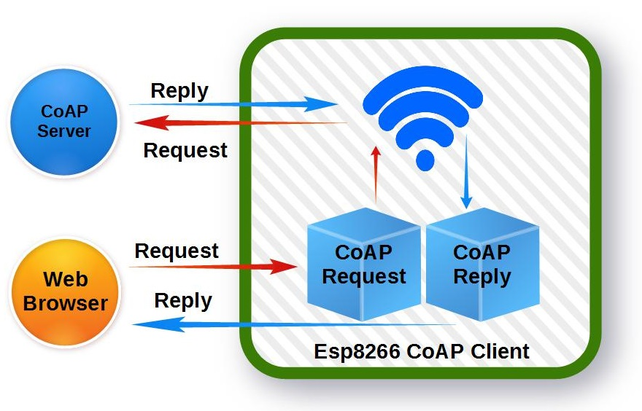
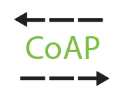

10.CoAP
Constrained Application Protocol
Machine-to-machine (M2M)
Like HTTP but only runs over UDP protocol
Support GET, PUT, POST and DELETE methods
5.0
24

Slide 25
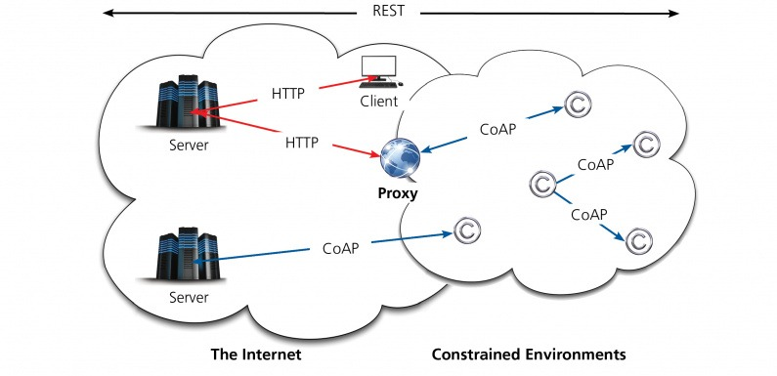
How CoAP Works?
5.0
25

Slide 26
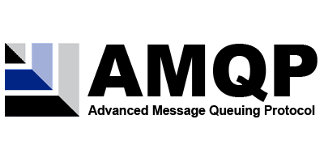
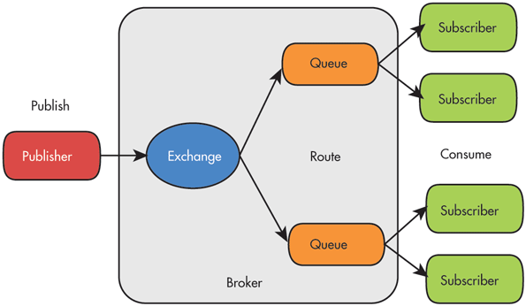
11.AMQP
Advanced Message Queuing Protocol
An open standard for passing business messages
Runs over TCP protocol
5 versions (0-8, 0-9, 0-10, 0-9-1, 1.0)
5.0
26

Slide 27
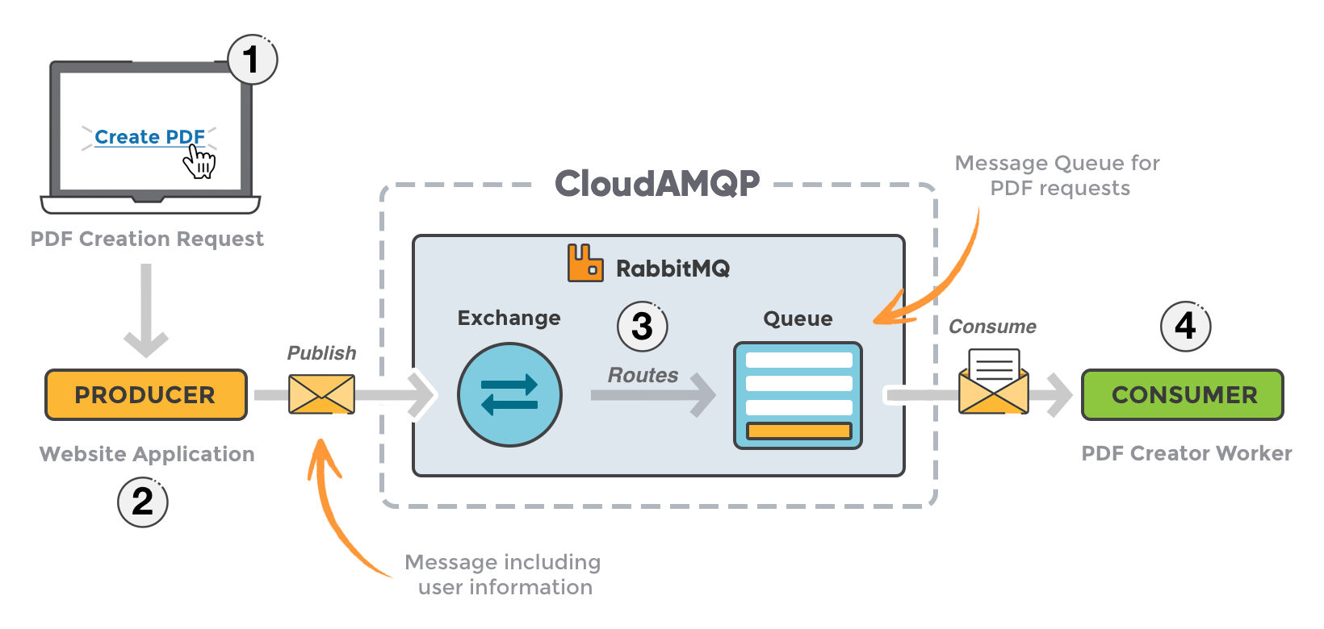
How AMQP Works?
5.0
27

Slide 28


Thank you!
Email
Website:
Vietnam:
North America:
+84-2839-951-059
+1 844 224 4188
Australia:
Japan:
+61 414 734 277
+81 364 324 994
Email
Website:
innovation@tma.com.vn
http://tma-innovation.center
Notes:
28

